Slide 1
West Nile Virus Prediction
Predict West Nile virus in mosquitos across the city of Chicago

Slide 2
Overview and Problem- Big
Chicago Department of Public Health (CDPH) concerned about West Nile Virus epidemic:
The potential rate of West Nile virus presence in Chicago
Where the presence of West Nile virus is observed?
We assume that it may originate from one point and then spread to nearby areas
When we observed the presence of West Nile virus?
We aim to analyze past data to identify the week or month with the highest virus prevalence

Slide 3
Dataset - Big
Train Data
Weather Data
Spray Data
Test Data

Slide 4
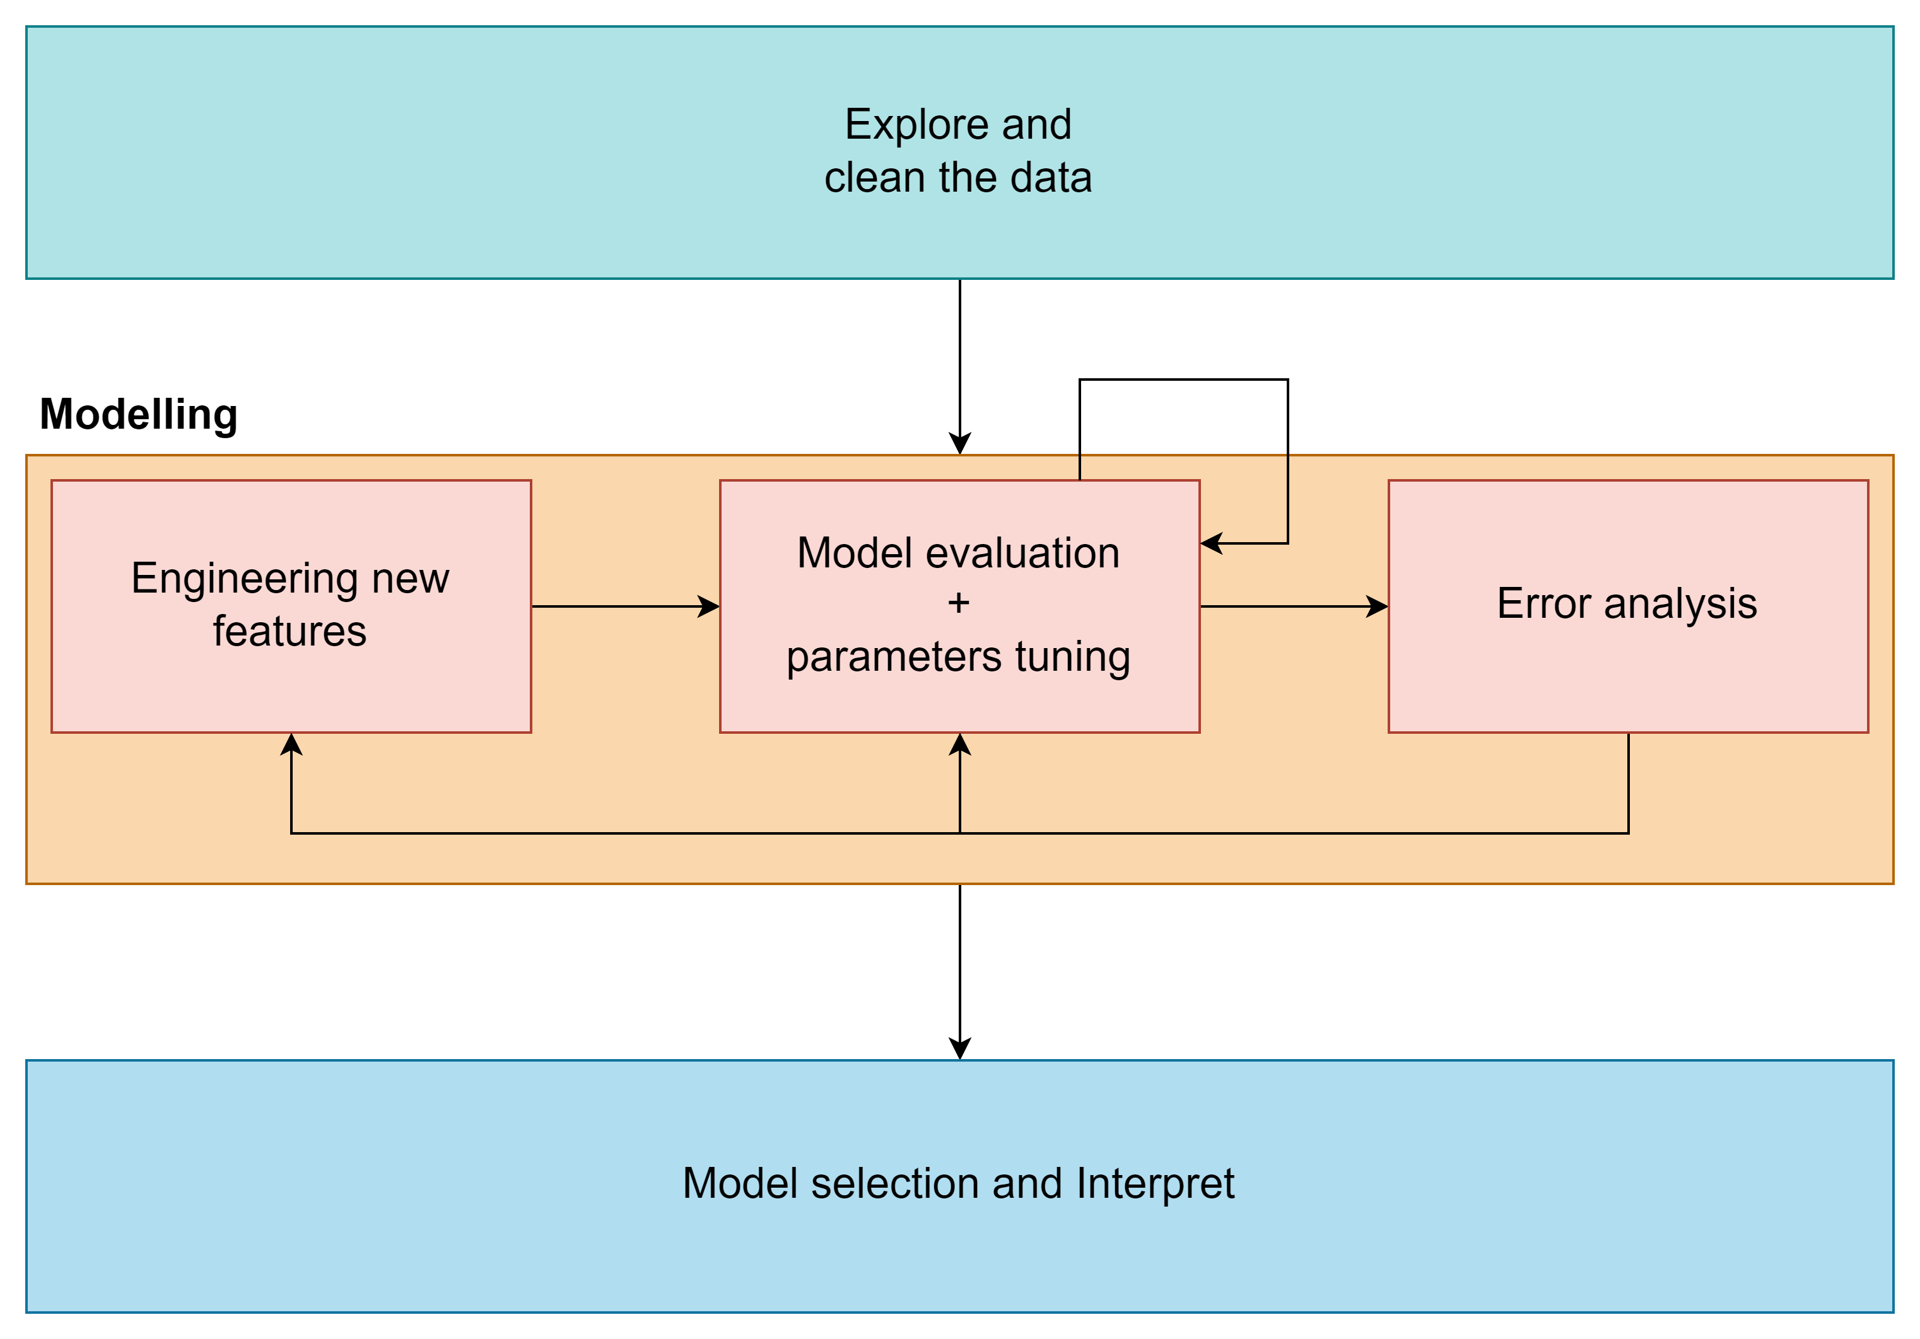
Process

Slide 5
EDA & Cleaning – P’A
Spray: unused with reasons
Weather
Drop correlated feature
Any cleaning ?
2 Stations distribution
Merge 2 station into average
Train
Data value correction
Distribution
Have virus vs no virus by species
Month with virus

Slide 6
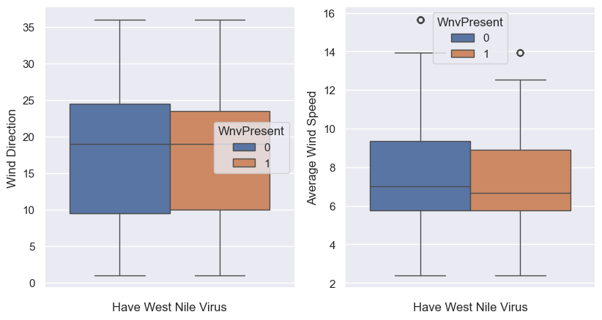
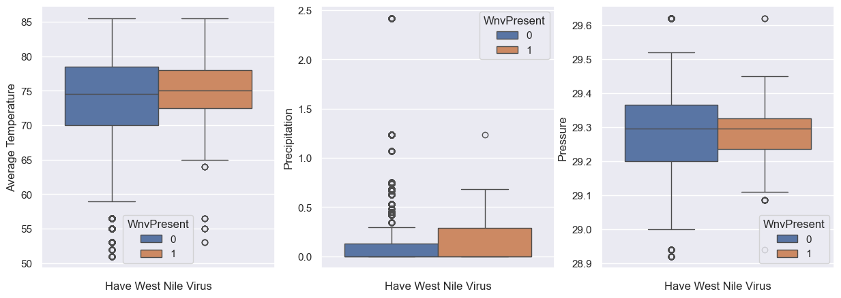
Feature Selection Weather
One that correlated with WNV
Average Temp.
Average Wind Speed
Uses moving average value

Slide 7
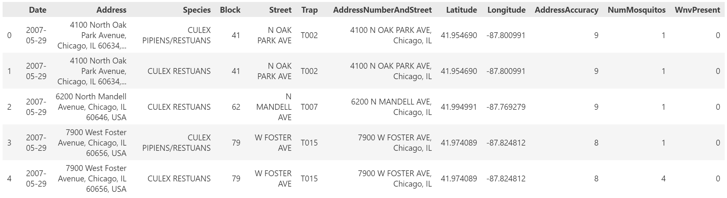
Feature Selection & Engineering Train data - Location and Time
Location
Latitude
Longitude
Time - Extract from date
Weeknum (week of year)
Year

Slide 8
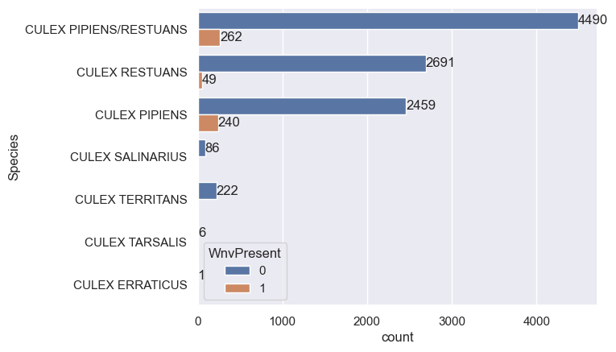
Feature Selection & Engineering Train data – Species

Slide 9
Feature Selection & Engineering Train data – Time related
The number of mosquitos missing in test data
Solution: Use records count instead
Difference of number of records from previous and current week

Slide 10
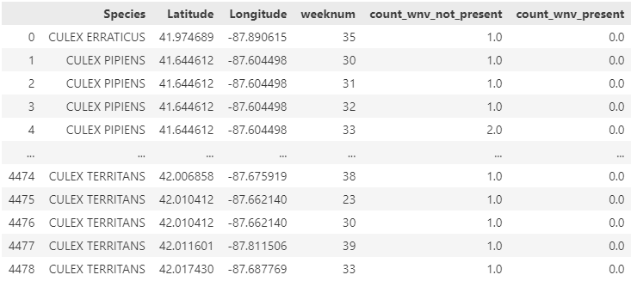
Feature Selection & Engineering Train data – West Nile virus presence proportion
Calculate the number of records by species, location (lat/long) and week of year
From the number of records, using the average number of records to calculate proportion

Slide 11
Model Selection - Big
Scoring method
Error analysis
Grid search
Selected model
Logistic Regression

Slide 12
Hyperparameter Tuning
Model Name | Test AUC Score | Features | Parameter
Logistic Regression | 0.84
Random Forest | 0.84
Regularized Greedy Forest (RGF) | 0.84
XGBoost | 0.81

Slide 13
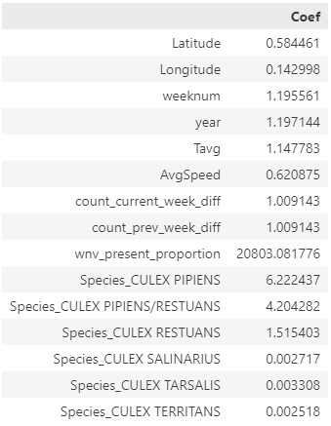
Summary & suggestion
Model for prediction – using XGBoost ?
Inference – using Linear Regression
Mosquitos control, cost effective suggestions

Slide 14
Model Limitation – P’A
Number of train data
Time period
Need periodically retrain ?
Species that model can predict, if there are any new species ?

